Slide 1
AquaSense
Water Supply Network Monitoring System

Slide 2
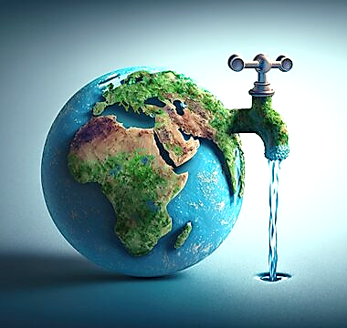
Water Supply Challenges
Insufficient raw water
Poor quality surface water
Inequitable distribution
Wastage and Economic Impact
3% safe water
40% estimated loss in distribution
66% people may face shortage in near future
Smart Water Management Solutions
Real time monitoring
Consumption measurement
Dynamic regulation
Leakage control
INTRODUCTION

Slide 3
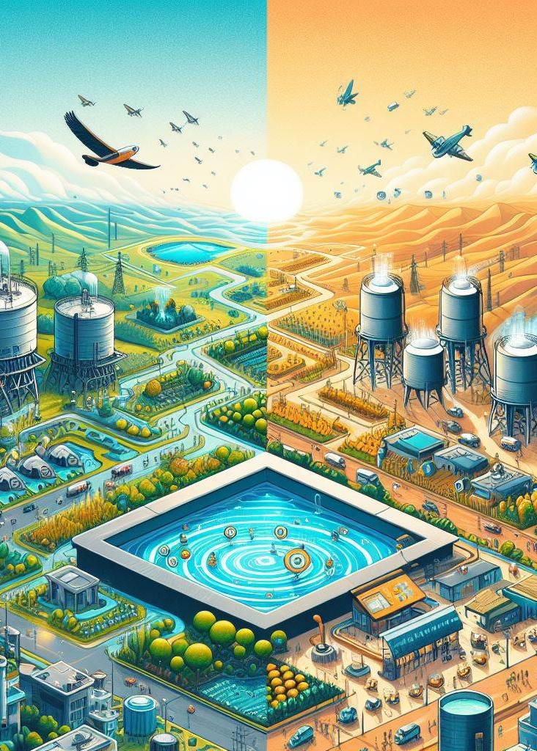
Jal Jeevan Mission
Jal Jeevan Mission was launched with the vision of providing drinking water in adequate quantity of prescribed quality on regular and long-term basis to every rural household. A cost-effective technology is required for providing web/ mobile based tool for mapping of water supply network through creating geospatial database of all major structure of Water supply system with provision with grievance redressal.

Slide 4
Literature Survey
System to monitor water supply in Delhi
How Delhi implemented water supply monitoring system
Smart Water Management Technologies: A Way Forward for Achieving Sustainable Development Goals in India
Role of SCADA, PNMA and GIS in Promoting Efficient Water Management Practices
A risk-based soft sensor for failure rate monitoring in water distribution network via adaptive neuro-fuzzy interference systems
Gheibi, M., Moezzi, R., Taghavian, H. et al. ; Sci Rep 13, 12200 (2023).
Modelling different statistical distributions for the evaluation of failure rates based on effective parameters
Decision support systems for leak control in urban water supply systems: A literature synopsis
Thabane H. Shabangu, Yskandar Hamam, Kazeem B. Adedeji,
Procedia CIRP, Volume 90, 2020, Pages 579-583, ISSN 2212-8271
City Water Supply Networking Monitoring Solution (2017-12-05 Author :Baima PV :4411)
Real-time monitoring of urban water supply networks through unmanned remote systems.
Public Utilities Board Singapore. Managing the water distribution network with a Smart Water Grid.
Public Utilities Board Singapore ; Smart Water 1, 4 (2016).

Slide 5
OBJECTIVES
Transparency
Improve the transparency of all the processes in the water sully chain.
Immediate response
Identify or even predict issues and respond to minimize the damage.
Automation & optimized use of human resources
Partially or fully automate life cycle of providing water to consumers.
Sustainability
Technologies are no longer a source of savings and higher efficiency only, but the means to reach different environmental goals.

Slide 6
Purpose
01
Platform to revolutionize water supply network management
02
Monitor water supply infrastructure effectively
03
Enhance visibility and accessibility
04
Build awareness about water conservation and responsibilities

Slide 7
Features
1
2
3
Real-time Monitoring
GIS Integration
Analytical Insights
4
5
6
7
Grievance Redressal
Community Engagement
Alerts
Notifications
Usage Tracking
Automatic Billing
Accessibility
Scalability
Compatibility
Security
Privacy
and much more ….

Slide 8
Technology Stack
Fa
R
P
FastAPI
React
PostgreSQL
A modern Python web framework, renowned for its high performance, simplicity, and automatic interactive API documentation, to streamline development and enhance the scalability
A popular JavaScript library for building dynamic user interfaces, offering a component-based architecture and efficient rendering.
A powerful open-source relational database management system, recognized for its scalability, reliability, and advanced features.

Slide 9
Practical Aspect and Viability
User-centric Approach
Swift Fault Reporting
The web application is designed with user-friendliness in mind. Intuitive interfaces ensure that individuals of varying technical expertise can easily navigate and utilize the platform.
The platform enables users to promptly report pipeline issues by submitting images and location data. This streamlined reporting process ensures quick responses from maintenance teams.
1
2
3
4
5
Solving Real Problem
Visualizing Infrastructure
Data-driven Decision Making
The project addresses a critical issue: inadequate access to clean water in rural areas. By creating a digital platform, it offers a tangible solution to improve water supply management.
Users can interactively explore the water pipeline network through maps and simulations. This feature provides a clear visual representation of the infrastructure, enhancing understanding.
Robust analytics offer deep insights into fault frequency, water supply timelines, and usage patterns. This information empowers decision-makers to allocate resources more efficiently.

Slide 10
Market Potential
01
02
03
04
05
Government Initiatives
Environmental Concerns
Technological Advancements
Regulatory Compliance
Infrastructure Development Projects
Government bodies worldwide are increasingly focusing on improving water supply infrastructure and management.
Growing environmental awareness emphasizes the need for responsible water usage and conservation.
The integration of advanced technologies, such as GIS, and data analytics, in water supply management is gaining traction.
Stringent regulations regarding water quality and supply necessitate advanced monitoring and management systems.
The construction and expansion of water supply networks, especially in rapidly urbanizing areas, create a demand for effective management tools.

Slide 11
Work Flow
GitHub
Using GitHub for collaboration, task management and tracking progress
Front-end, Back-end
Parallel development of interface as well as server side and building APIs and document each step
Testing and Debugging
Module wise integration and troubleshooting
(Dummy) Deployment and Maintenance
Make it public and monitor the system with different simulations to check performance

Slide 12
Work to be done on
01
02
03
Risks
Challenges
Dependencies
Data Accuracy
Reliability
Geospatial Data Acquisition
Maintaining User Engagement
Data Providers / IOT devices
Technological Infrastructure
Collaborations with Authorities

Slide 13
THANK YOU

